Slide 1
External GPS setup for ArcPad on Mesa 2
14APR2016
Juniper Systems, Inc.

Slide 2
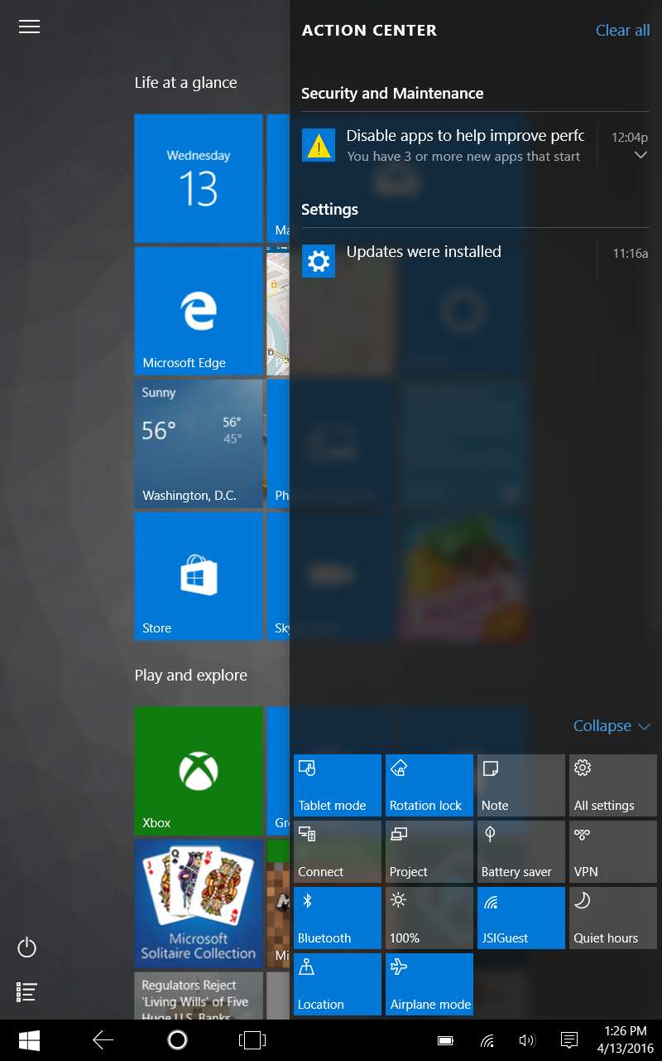
From the Mesa 2 home screen access the Settings control panel

Slide 3
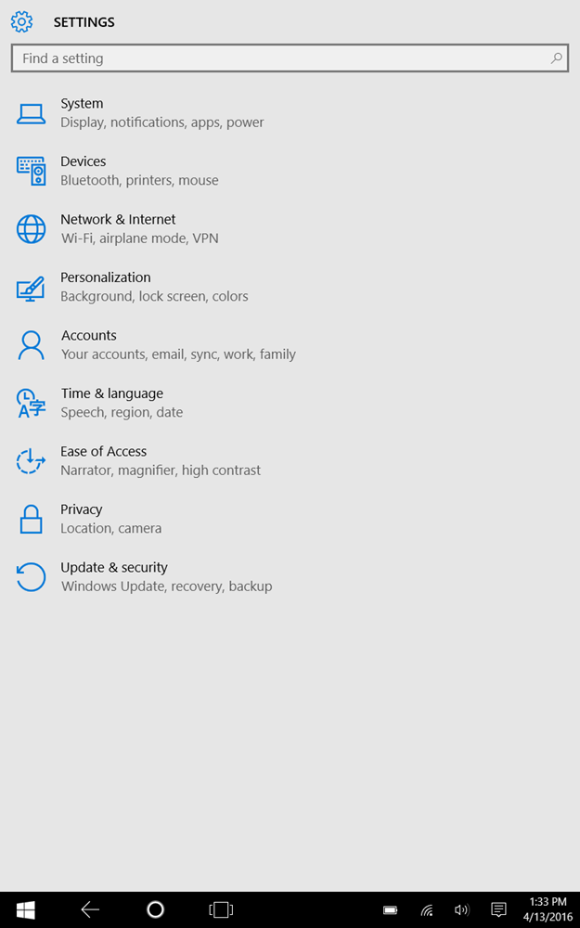
Select “Devices”, where the bluetooth control panel is located

Slide 4
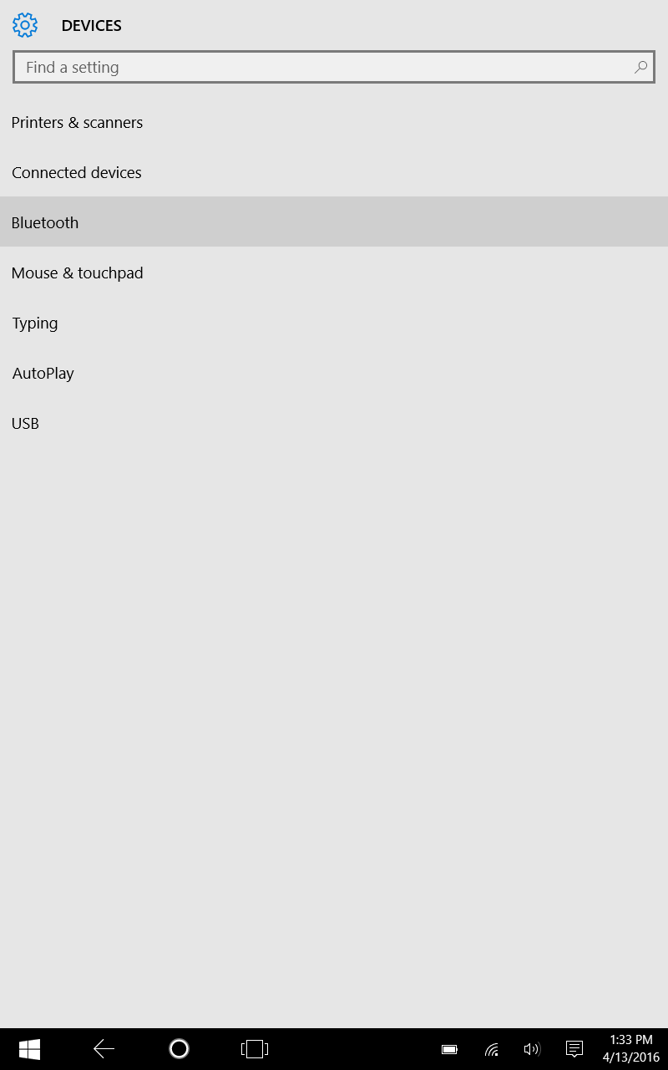
Select “Bluetooth” to access the bluetooth control panel

Slide 5
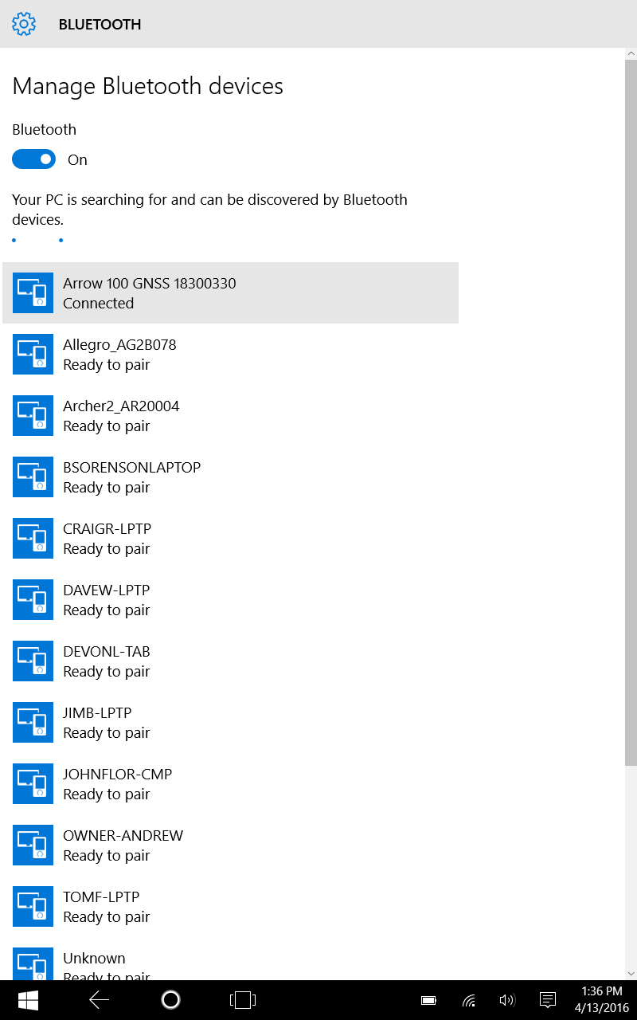
Slide the Bluetooth slider to “ON” to enable Bluetooth. Available devices will begin to appear in a list below

Slide 6
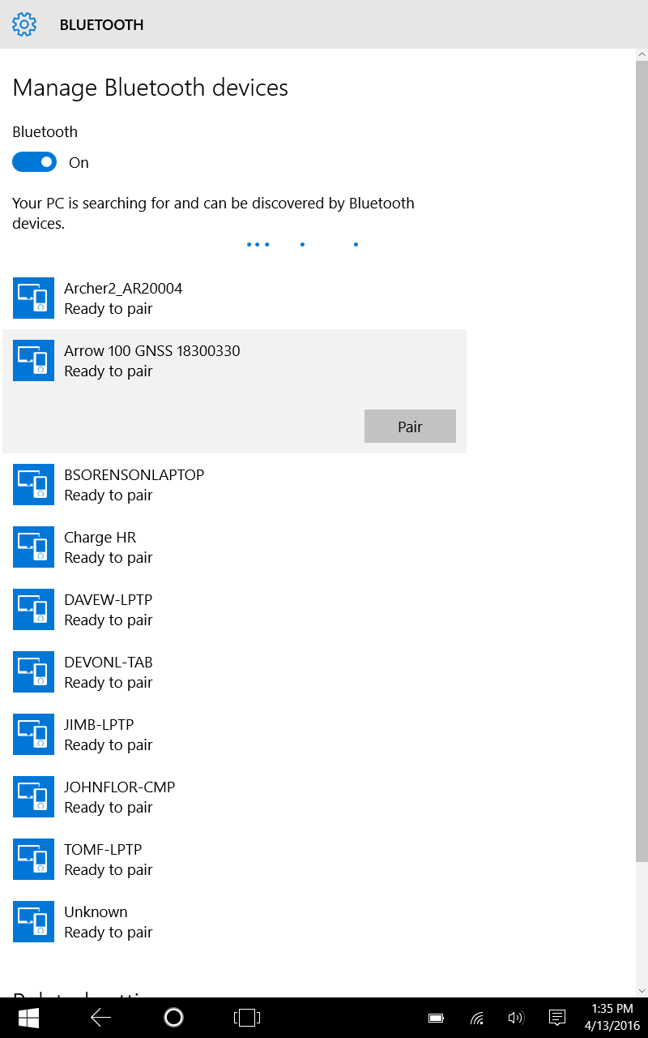
Click on the “Arrow 100 xxx” or similar GPS bluetooth device, and click on “pair”. PC will display “connected”.

Slide 7
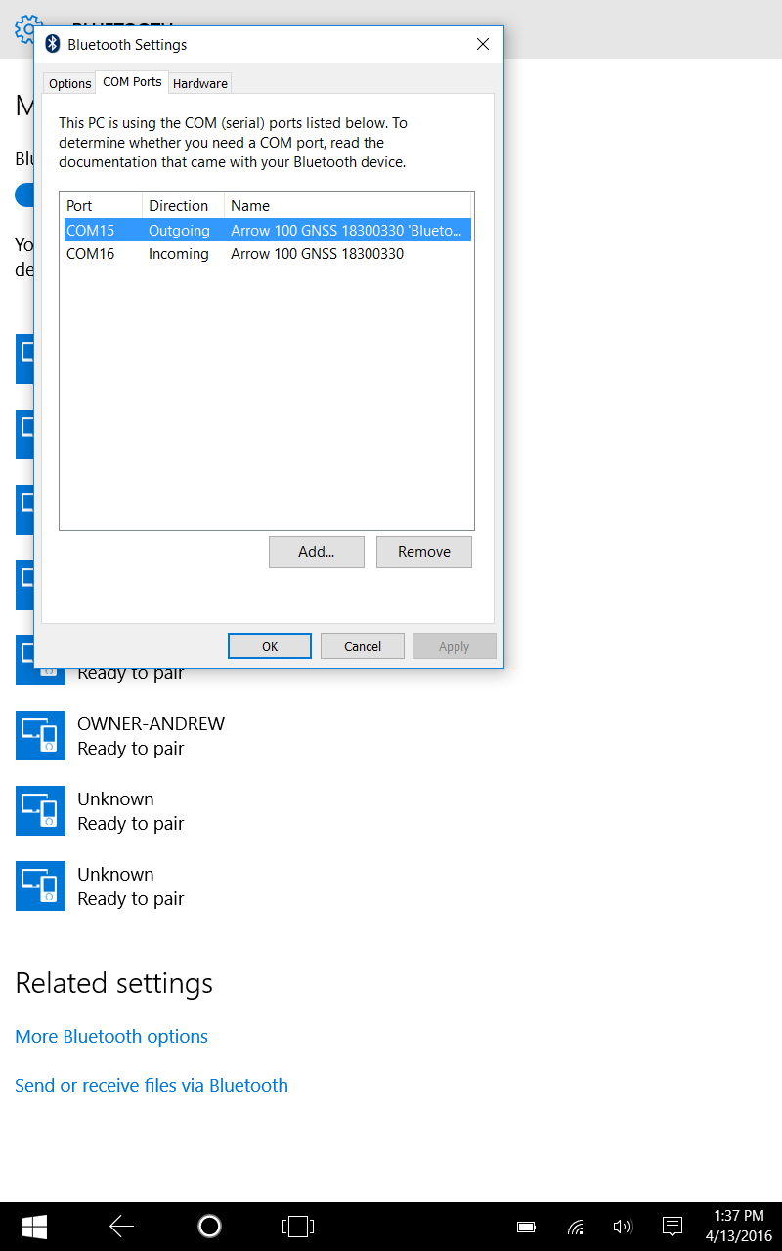
Check the outgoing com port assigned to the BT GPS; this is the port that you will select in ArcPad. Close the Settings control panel

Slide 8
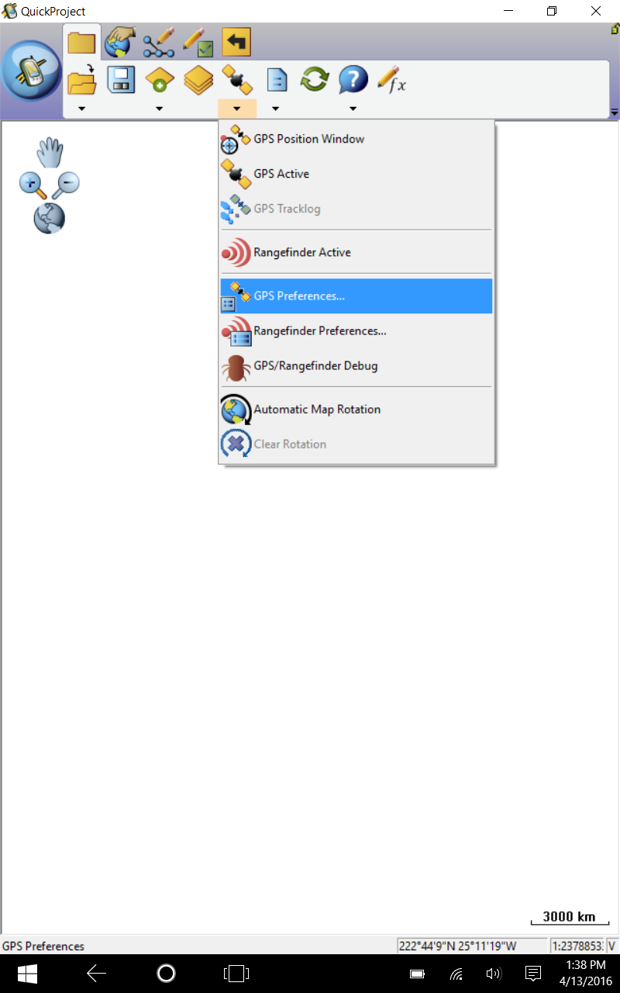
Launch ArcPad. Select GPS Preferences.

Slide 9
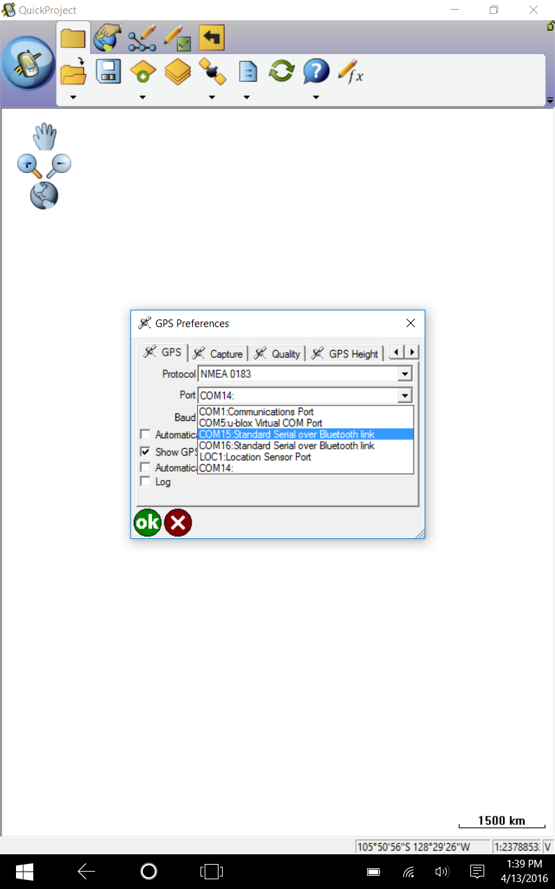
Select “NMEA 0183”, and select the com port for the connected bluetooth port. (baud rate setting not required for bluetooth connection). Press OK.

Slide 10
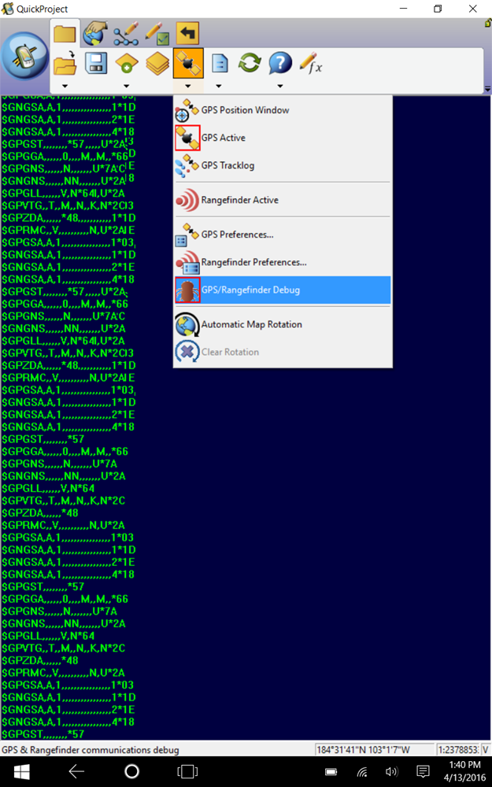
Select GPS/Rangefinder Debug to confirm the connection works. NMEA data will display on the screen.

Slide 11
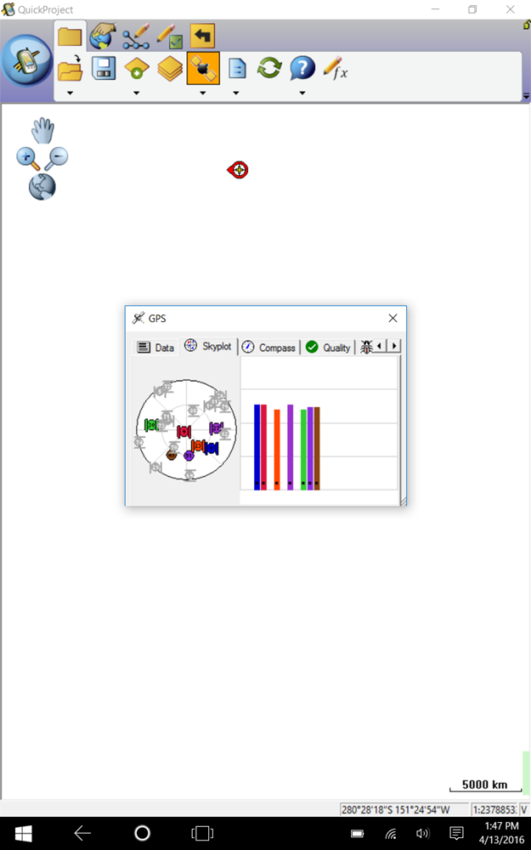
Select GPS Position Window to confirm position data is being received.

